Slide 2
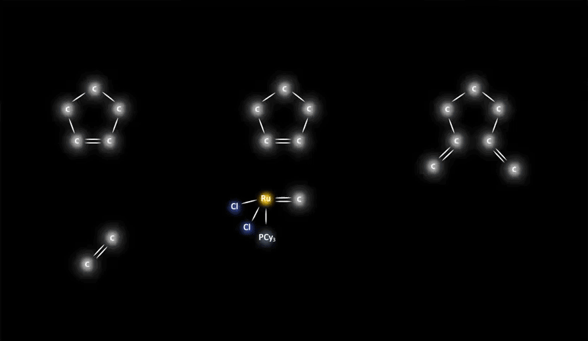

Slide 13
Ring Opening Metathesis Reaction Mechanism Animations by Savannah Hall and Janet Coonce, Tennessee Tech University, freely available under a © 2017 Creative Commons Attribution-NonCommercial-ShareAlike 4.0 International License at www.animations.connectingchemistry.com/TTU

